Slide 1
Y6
Sacred Heart School
17th – 19th May
2021

Slide 2
Monday 17th – Wednesday 19th May 2021
Mrs. Eccles, Mrs. Horsfall, Mr. Gibson
Luggage to school on Monday morning.
Leave school straight after registration on Monday
Travel by coach to Todmorden - arrive 10:45 – canal walk to the sight (including a fairly steep walk through woods), dorms - make beds up/lunch.
LET US KNOW IF YOUR CHILD IS TRAVEL SICK
FULL TIMETABLE. Activities begin after lunch on the first day – outdoors most of the time
STAFF ARE AWARE OF ALL DIETRY AND MEDICAL NEEDS OF CHILDREN. These are taken in to account accordingly, will modify an activity to suit needs of the child

Slide 3
What to bring
It is not necessary to bring all items given on the suggested clothing list; this is only a guide to items which it may be useful to include.
We would advise practical, hard-wearing clothing suitable for the inevitable wear and tear of an activity course, May weather can be cool/cold so include a warm fleece. SUNSCREEN!
All specialist equipment, including buoyancy aids and helmets, are provided by Robinwood Activity Centre. Sets of waterproof cagoules and waterproof over trousers, are available to put on whenever needed
£2.00 Tuck shop/souvenir money – a price list for souvenirs will be provided.

Slide 4
What not to bring
Please do not bring valuable items such as mobile phones, cameras, radios, iPads/tablets, expensive watches or any computer games.
Please do not bring any aerosol sprays. The fire alarm is sensitive in order to ensure high standards of fire safety and aerosols sprayed near any of the many smoke alarm sensors can set off the fire alarm for the whole centre.

Slide 5
Meals
Robinwood caters for many thousands of children each year, including many with special dietary requirements. There is always a vegetarian option available.
All groups attending Robinwood have a cooked breakfast and a cooked evening meal each day. A lighter lunch is provided, water is available throughout the day, and a hot drink and biscuits are offered to all children before bedtime.
Breakfast:
Cereals and toast are available for breakfast each morning, together with a cooked breakfast. Children may choose from sausage, beans, bacon, potato waffles and toast.
Lunch:
Children have a packed lunch on their arrival to the centre on the first day. Sandwiches are also offered every day of the course but wraps and other alternatives will be offered on days two and three. A selection of sandwich fillings are offered which typically include ham, cheese, jam and tuna. Fruit, crisps and a chocolate biscuit are also offered.

Slide 6
Meals:
Evening Meal:
Typical evening meals include Pizza, Fish Fingers, Pasta Bolognaise or Baked Potato. Sweets offered include Ice Cream and Chocolate Mousse.
Squash and water is available with all meals. Hot or cold drinks are also available for children when out on activities.
There is always a choice available. Children will be asked by their group leader on the first day to choose their meals for the rest of the course.
Water and fresh fruit is available throughout the day so that drinks and a healthy snack are available free of charge when needed.

Slide 7
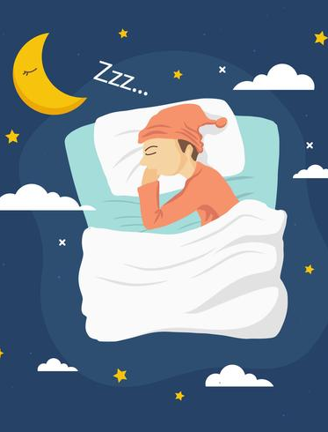
Evening activities finish at 9.00pm and there is then a settling down period of around 30 minutes when the children meet with their teachers, course leader and the night duty staff for hot chocolate and biscuits. Following on from washing and brushing teeth the children are in bed with lights out by 10:00pm.
There is a team of Robinwood staff timetabled on ‘bedtime’ duty, along with the teachers, to ensure that all children get settled and to sleep in their dormitories reasonably quickly. Once the children are quiet and mostly asleep the number of staff on duty reduces, but there will always be at least one male and one female member of staff awake and on duty throughout the night. Mrs. Eccles will also be on call each night.

Slide 8
In the morning from around 7.30am, additional staff are timetabled on ‘wake-up’ duty. The wake-up duty staff will come to the dormitory door in time to get the children up and dressed, with all their kit packed as required for the day’s activities and children ready to get down to breakfast, which is served at either 8:00 or 8:30am, in good time.
Activities begin straight after breakfast; each one usually lasts around an hour. There will be 15 exciting activities over the whole stay that focus on challenge, developing teamwork and stimulating the imagination. Children are encouraged to take part in all but will not be made to at any time if they don’t want to.

Slide 9
Groups and dorms
At the moment, we do not know which dorms we have been allocated (Castle/new block).
Sacred Heart staff rooms are close by.
The dormitories are allocated just for our school, our activity groups will be for children just from our school. Although there are separate sittings for meals it is possible that there may be other schools in the dining room at the same time as (lunchtime).
Groups are very carefully chosen. 2 x 10, 1 x 11
We have a team of staff, with a course leader in charge and a group leader for each activity group, plus Mrs. Eccles, Mrs. Horsfall and Mr. Gibson throughout the 3 days of our Robinwood course.

Slide 10
Telephone contact whilst children are away
Children should leave mobile phones at home.
Although homesickness generally isn’t a problem, if children do get on the telephone to parents, particularly on the first night, this can make a potential home sickness situation significantly worse.
Any contact that needs to be made will be made through Mrs. Eccles.
Children do not need to be able to swim to take part in Robinwood water sports, they should be confident in water (in other words they would not panic if they fell in). Watersports take place on very sheltered water; just over a metre deep, with children no more than 15 metres from the bank at any time. Everyone on the water wears a buoyancy aid and a canoe helmet.

Slide 11
We will leave the centre after an early lunch on Wednesday, hoping to arrive back in Ilkley at home time – around 3:15pm.
We are in regular contact with the office staff to keep them informed of any delays that may occur on the journey.
School as usual on Thursday!

Slide 12
Any
questions?

